Slide 1
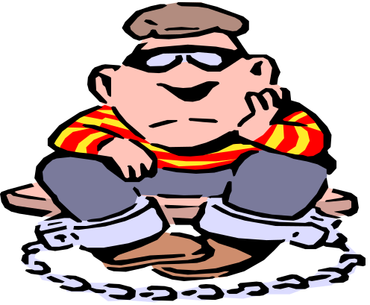

What is plagiarism?
Say No To Plagiarism
(And why you should care!)
Say No To Plagiarism

Slide 2

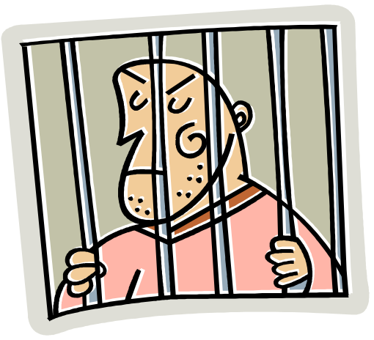
Definition:
Plagiarism is the presenting the words, ideas, images, sounds, or the creative expression of others as your own.

Slide 3

Did You Know?
The word plagiarism comes from the Latin plagiarius meaning "kidnapper"

Slide 4
How serious is the problem?
“A study of 4,500 students at 25 schools:
72% admitted to serious cheating on written assignments using the Internet.”
Based on the research of Donald L. McCabe, Rutgers University
Source: “CIA Research.” Center for Academic Integrity, Duke University, 2003 <http://academicintegrity.org/cai_research.asp>.

Slide 5

Students, If:
you have included the words and ideas of others in your work that you neglected to cite,
You have probably plagiarized!

Slide 6


Two types of plagiarism:
Intentional
  Copying a friend’s work
  Buying or borrowing papers
  Cutting and pasting blocks of text from electronic sources without documenting
  Media “borrowing”without documentation
Unintentional
  Careless paraphrasing
  Poor documentation
  Failure to use your own “voice”

Slide 7

Excuses
It’s okay if
I don’t get caught!
Everyone does it!
I was too busy to
write that paper!
(Job, big game, too much homework!)
This assignment
was BORING!
I’ve got to get
into a
certain college.!
My teachers
expect
too much!
My parents
expect “A”s!

Slide 8

Plagiarism is a serious offense and can lead to failing grades or suspension from school.
Is your academic
reputation valuable
to you?
The consequences are not worth the risks!
It is only right to give credit to authors whose ideas you use
Citing makes it possible for your readers to locate your source
Cheating is unethical behavior

Slide 9

Real life consequences:
Plagiarism at UVA—
45 students dismissed, 3 graduate degrees revoked
  CNN Article AP. 26 Nov. 2001
  Channel One Article AP. 27 Nov. 2002

Slide 10
Consequences (cont’d)
New York Times senior reporter Jayson Blair forced to resign after being accused of plagiarism and fraud.
“The newspaper said at least 36 of the 73 articles he had written had problems with accuracy, calling the deception a "low point" in the newspaper's history.”
“New York Times Exposes Fraud of Own Reporter.” ABC News Online. 12 May, 2003.
http://www.pbs.org/newshour/newshour_index.html

Slide 11


Possible school consequences:
“0” on the assignment
Failing a class?
Receiving a lower grade?
Parent notification
Referral to administrators
Suspension or dismissal from school activities--sports and extracurricular
Is it worth
the risk?

Slide 12

How to avoid plagiarism
Quote and cite phrases, sentences, and paragraphs taken directly from the original source.
Quote and cite statistics, charts, graphs and drawings taken directly from the original source.
When you paraphrase or summarize, give credit to the original author.

Slide 13

Question:
Do I have
to cite
everything?

Slide 14
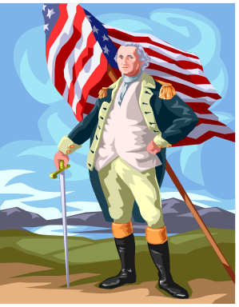
Answer: YES!!
Except –
  When you use your own words
  When the fact used is common knowledge.
  What makes it “common knowledge”?
  If you can find the same information in at least 3
  different sources, you don’t have to cite it.
  Ex. George Washington
  wore wooden dentures.

Slide 15

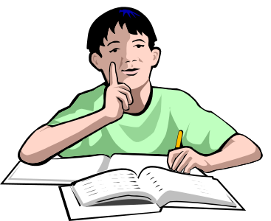
What’s the big deal?
Wrong! Paraphrasing
original ideas without
documenting
your source,
is plagiarism too!
If I change a
few words, I’m still okay,
right?

Slide 16

You can “borrow” from the works of others in your own work! Be very careful.

Slide 17


Use these three strategies,
Quoting
Paraphrasing
Summarizing
To blend source materials in with your own, making sure your own voice is heard.

Slide 18
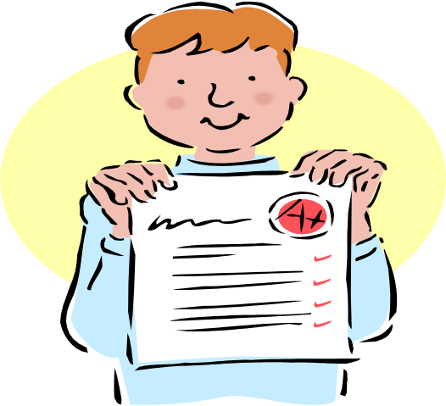
Quoting
Quotations are the exact words of an author, copied directly from a source, word for word. Quotations must be cited!
        Carol Rohrbach and Joyce Valenza

Slide 19
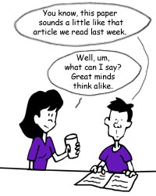

Paraphrasing
Paraphrasing means putting someone else’s words or ideas into your own words.
Although you are using your own words, the ideas are taken from someone else and must be cited on your Works-Cited page.

Slide 20
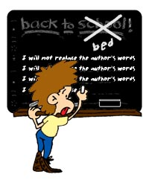
Paraphrasing
Paraphrasing is not simply rearranging or rewording an original passage.
You have to understand what the author is saying and write the ideas entirely in your own words.

Slide 21

Paraphrasing
Give the author credit when you quote or paraphrase.
“According to Jim Carty, the CATS are ranked fourth in backcourts this year with Rondo, Sparks, Crawford, Bradley, and Moss.”

Slide 22

As you take notes:
Include page numbers and source references so you can go back and check for accuracy as you write.

Slide 23


DON’T
Cut and paste from any source
Use another student’s work as your own
Just change a few words from any source for your paper
Turn in a paper you wrote for another class

Slide 24
A Plagiarist is:
Too careless
Too lazy
Too dishonest
TO DO A GOOD JOB!
By Cindy Nottage

Slide 25

You can prevent plagiarism
(stealing words and ideas).
All you need to do is:
Take notes—put in your own words.
If you do copy words, put “ ” around them and footnote whose words they are.
Keep track of EVERY resource you use!
Cite all of your sources at the end of your work.

Slide 26
Citing Sources at TLC: **On Website
BibMe:
Citation Maker
Citation Machine
KnightCite
*The official citation format for TLC is MLA.
.

Slide 27
Works Cited
“Boston Columnist Resigns Amid New Plagiarism Charges.” CNN.com 19 Aug. 1998 3 March 2003 <http://www.cnn.com/US/9808/19/barnicle/>
Fain, Margaret. “Internet Paper Mills.” Kimbal Library. 12 Feb. 2003. <http://www.coastal.edu/library/mills2.htm>
Lathrop, Ann and Kathleen Foss. Student Cheating and Plagiarism in the Internet Era. Englewood, CO: Libraries Unlimited, 2000.
Lewis, Mark. “Doris Kearns Goodwin And The Credibility Gap.” Forbes.com 2 Feb. 2002. <http://www.forbes.com/2002/02/27/0227goodwin.html>
“New York Times Exposes Fraud of own Reporter.” ABC News Online. 12 May, 2003.
<http://www.pbs.org/newshour/newshour_index.html>
Sabato, Larry J. “Joseph Biden's Plagiarism; Michael Dukakis's 'Attack Video' – 1988.” Washington Post Online. 1998. 3 March 2002. <http://www.washingtonpost.com/wp-srv/politics/special/clinton/frenzy/biden.htm>

